Slide 1



April, 2012
Ulaanbaatar Mongolia

Slide 2
Project sponsor: “EREENTSAV” JSC
Project location: Tainii Am, 10th khoroo,
Khan-Uul district, Ulaanbaatar, Mongolia
Total area of project: 20 hectare(200000m2)

Slide 3
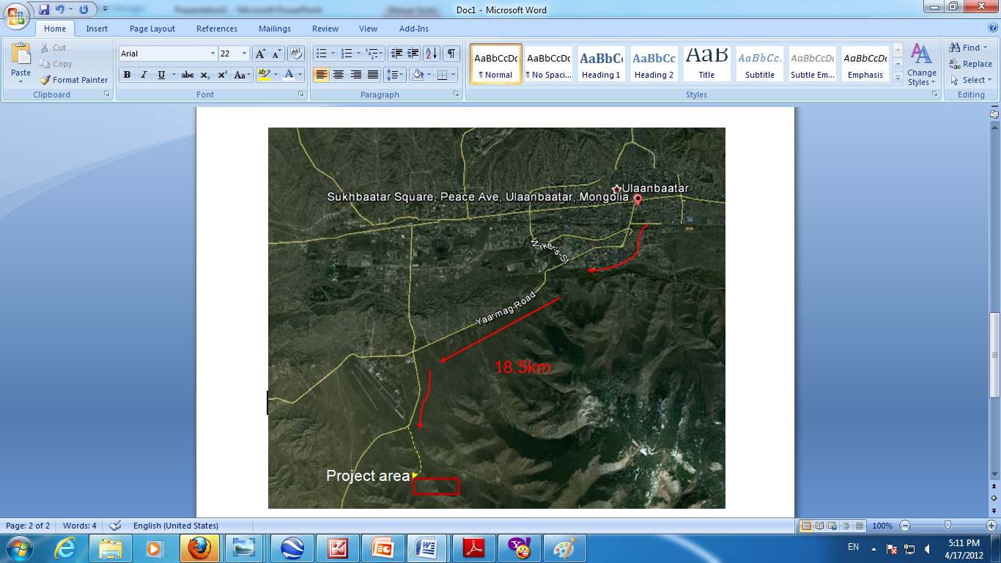
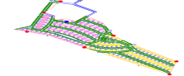
Project Location
Description
It situates 18.5 km from the Sukhbaatar square.
Road
Direction
Advantages:
· It is near to a mountain and bushes, offering smooth atmosphere, less dust and good air circulating, your family members will be free from allergy, asthma and other
respiratory diseases. Indeed it is a guarantee for your healthy living.
· Distance runner a city noise
· Have not traffic jam
· Near to the downtown

Slide 4
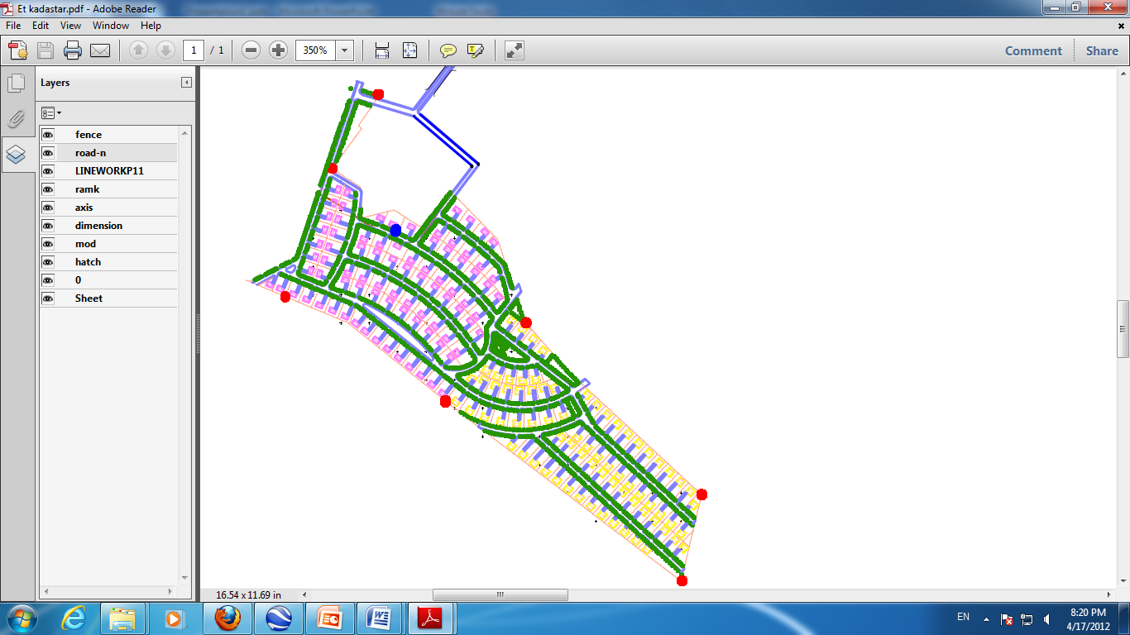
GENERAL PLAN

Slide 5
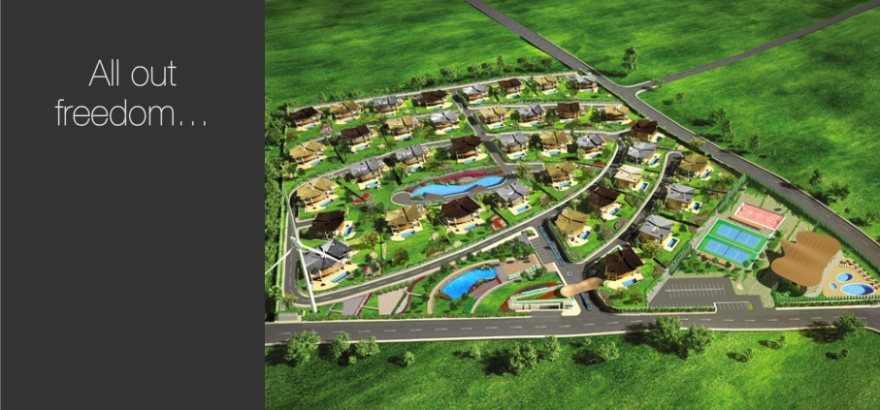
Appearance of VIP ECO Complex
VIP ECO Complex construction project will be located in the calm and beautiful nature with fresh air not far from the downtown. This village will be surrounded by a beautiful eco-system, including garden, fountains, green zone, scotch pines and spruces.

Slide 6

Power of water, sun, wind allows energy saving…
‘’VIP Eco Villa’’ in an 170 square meter lush area where 130 villa with gross 700 square meter positioned ; become prominent with eco-friendly, smart systems applications that enables energy saving. It values every single detail including retrenching from materials used in villa construction by considering future of our world against global climate change thread through producing its own resources, environmentalist project that enables recycling.
’’ VIP ECO Complex ’’ where natural resources used reasonable for a sustainable future, has been designed with high technology considering some notions like lower carbon emission, energy efficiency, renewable resources, temperature saving and recycling.

Slide 7
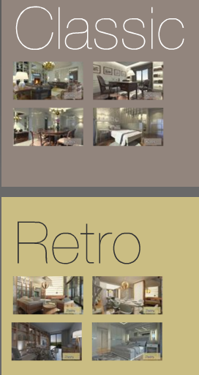
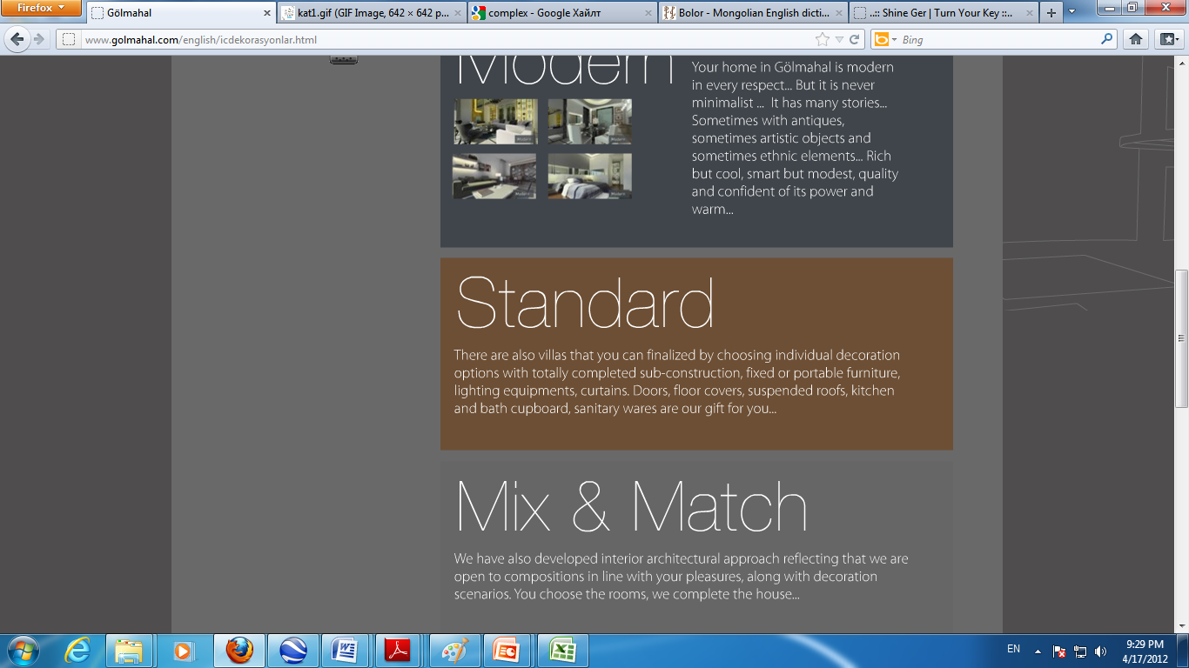
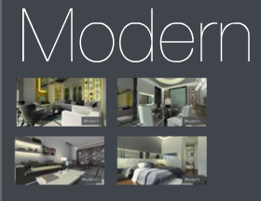
All Villa’s exterior and interior design and decoration are

Slide 8
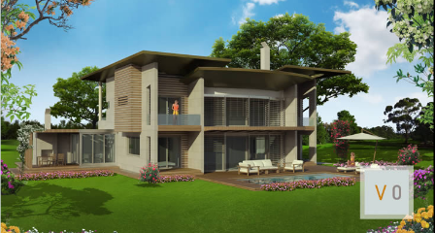

We will planned to build modern and luxury designed 3-4 types of 130 villa.
Type 1

Slide 9
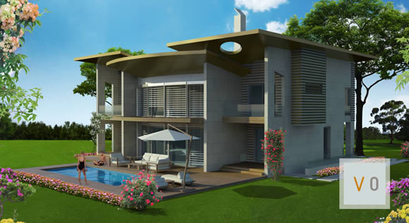

Slide 10
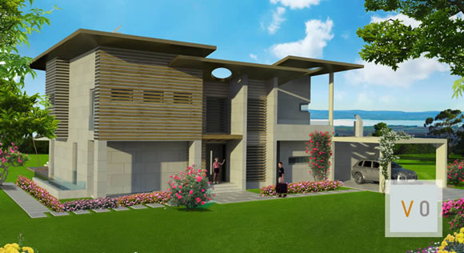

Slide 11


Slide 12
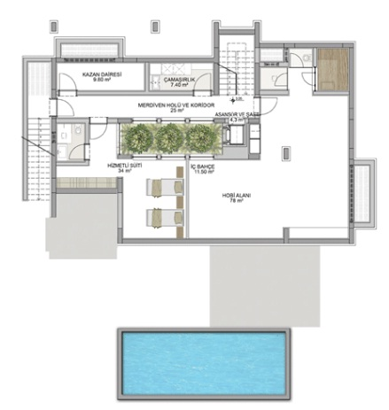
Basement
Site area- 170m2

Slide 13
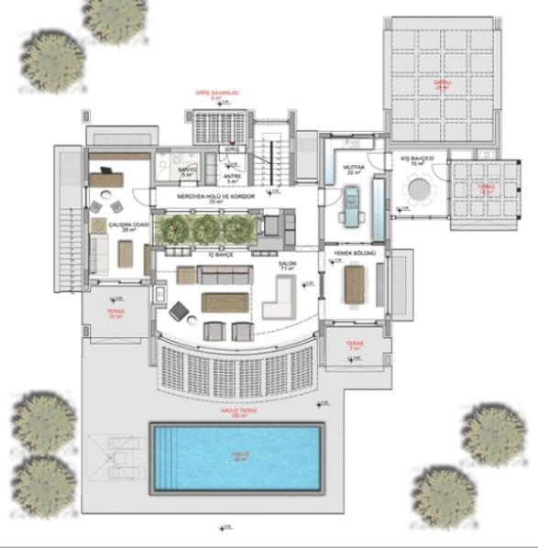
Ground floor
Site area- 384m2

Slide 14
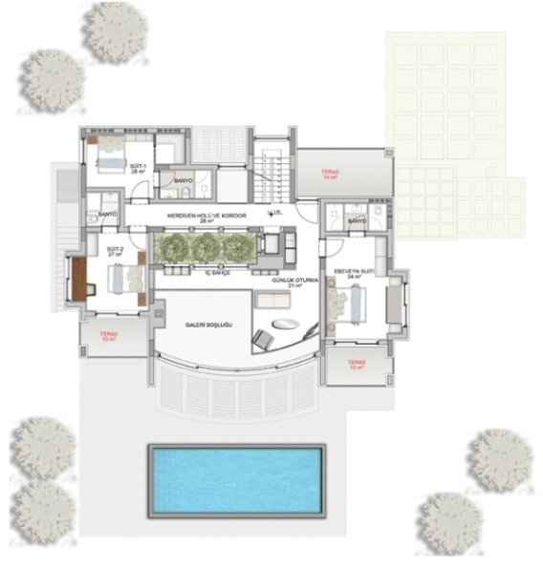
2nd floor
Site area- 172m2

Slide 15
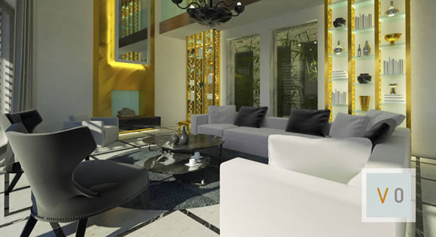
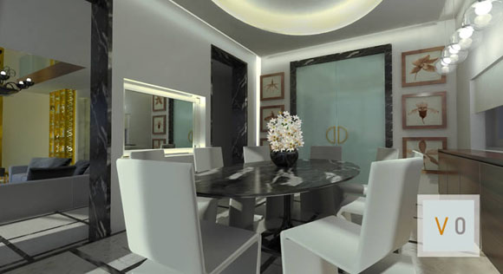
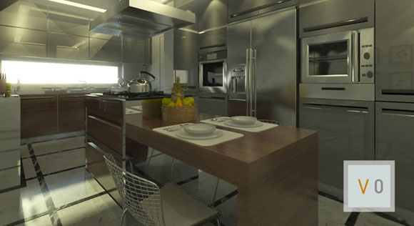
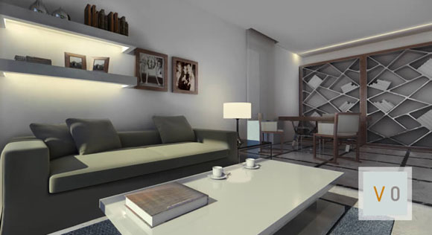
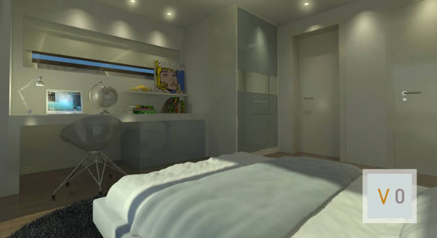


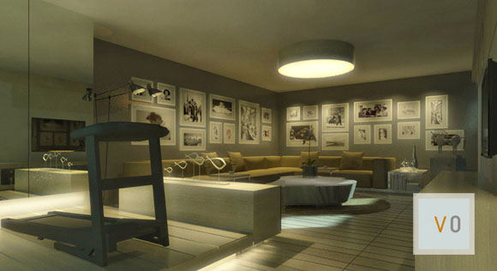
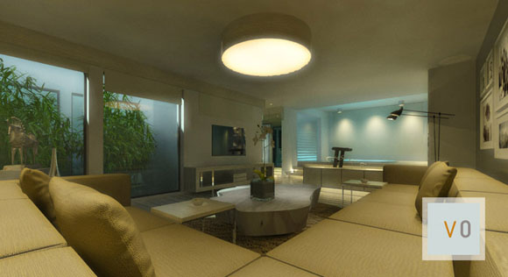
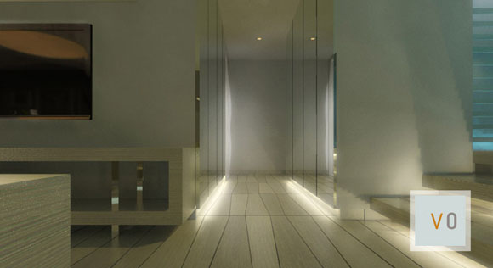
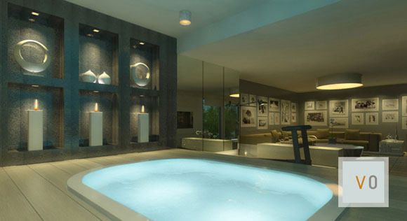
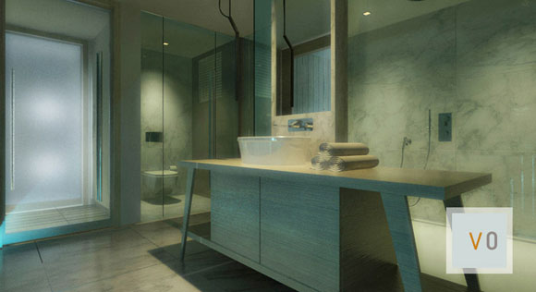

Slide 16
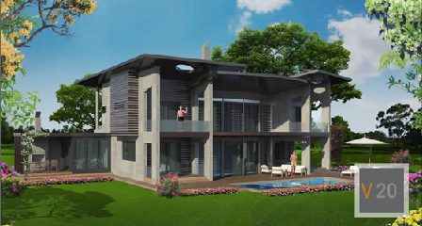
Type 2

Slide 17
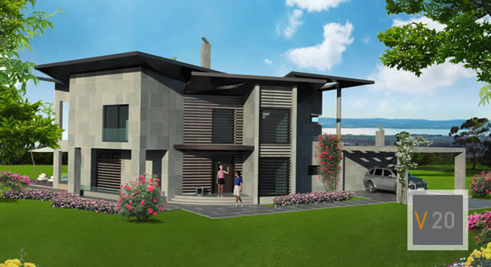

Slide 18
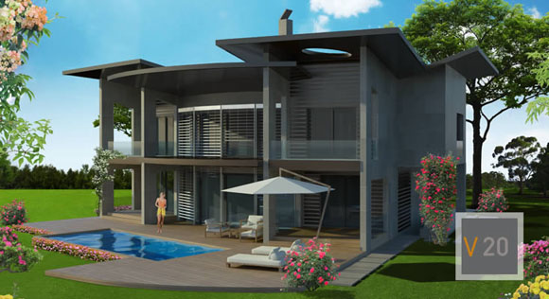

Slide 19
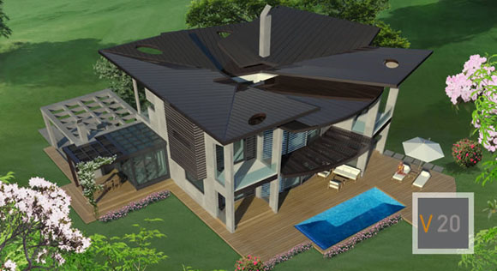

Slide 20
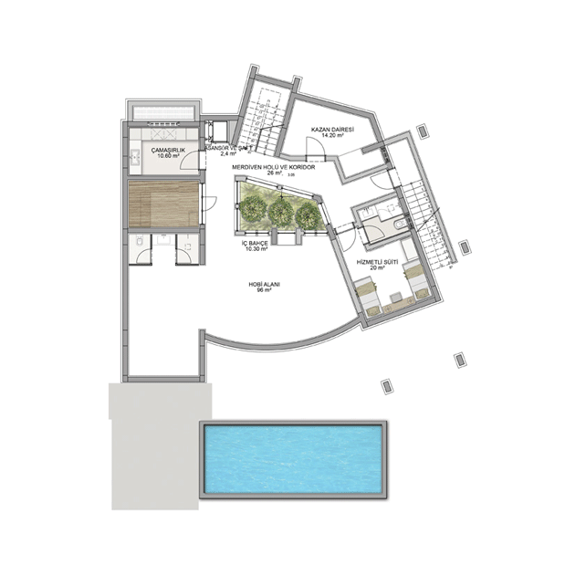
Basement
Site area- 179.5m2

Slide 21
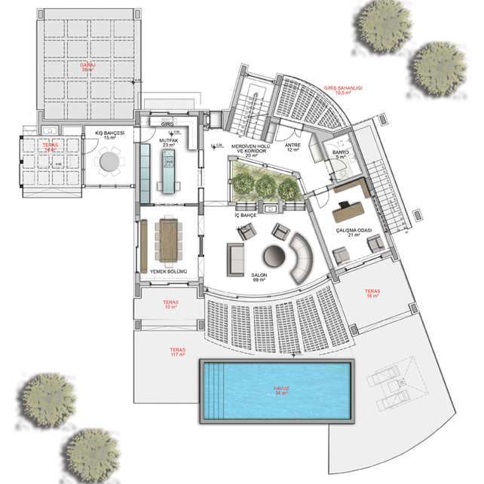
Ground floor
Site area- 408.5m2

Slide 22
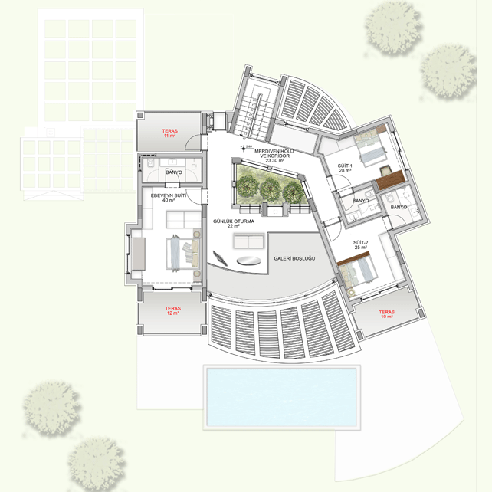
2nd floor
Site area- 171.3m2

Slide 23
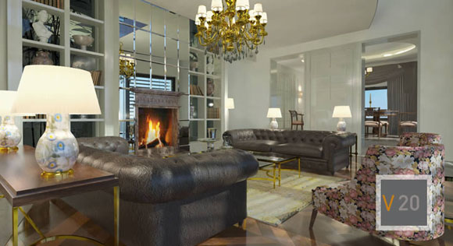


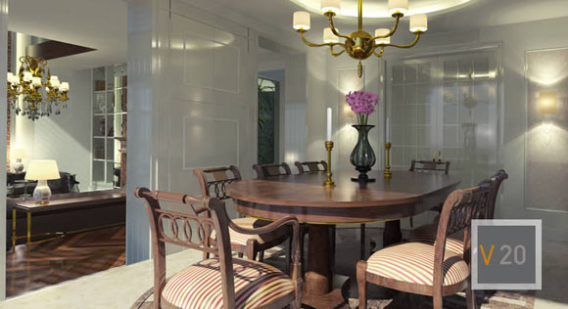

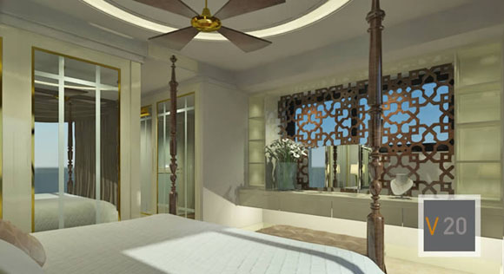
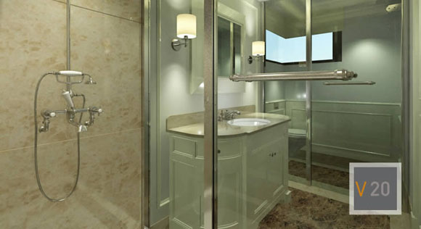
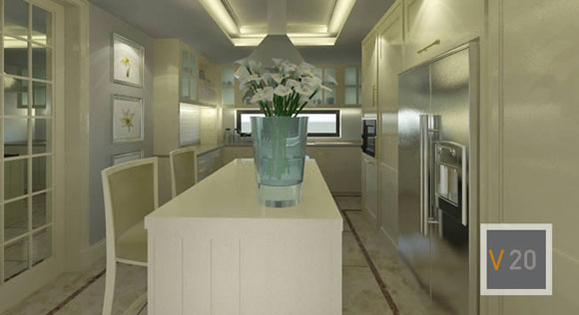
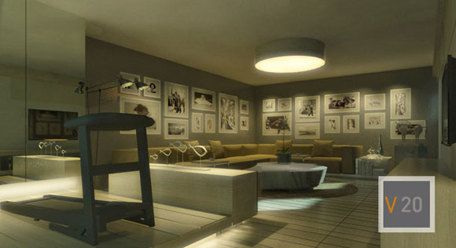
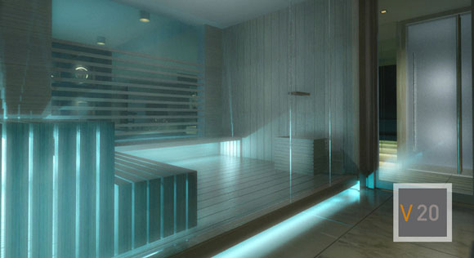

Slide 24
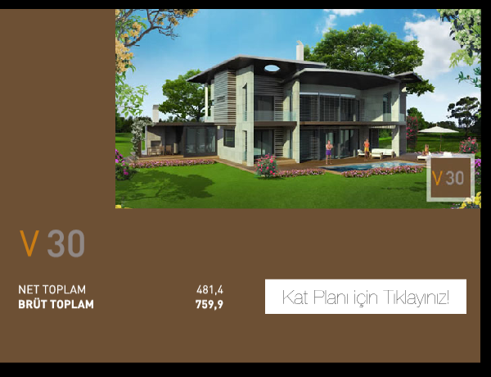
Type 3

Slide 25
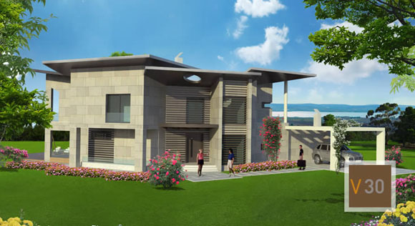

Slide 26
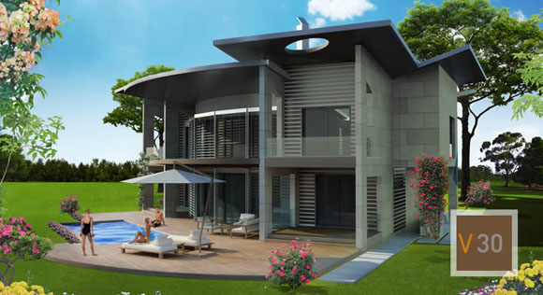

Slide 27
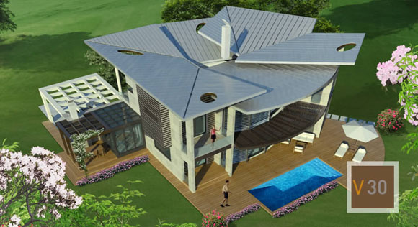

Slide 28
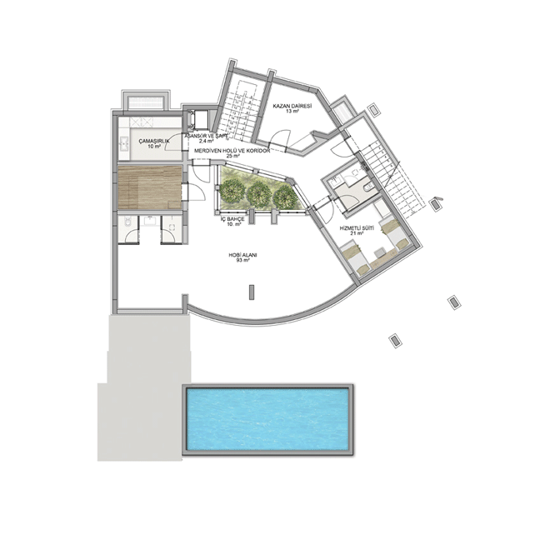
Basement
Site area- 174.4m2

Slide 29
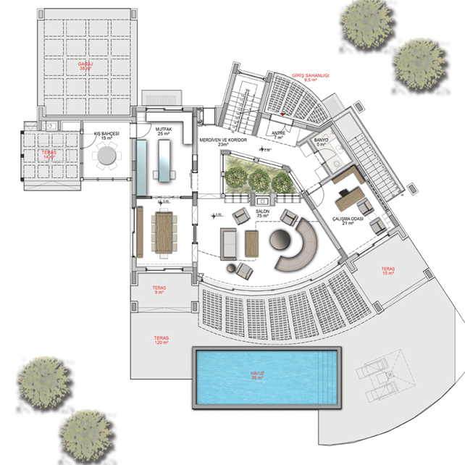
Ground floor
Site area- 414.5m2

Slide 30
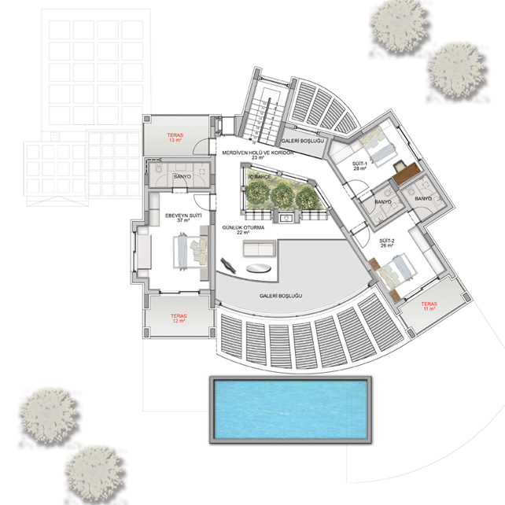
2nd floor
Site area- 171m2

Slide 31
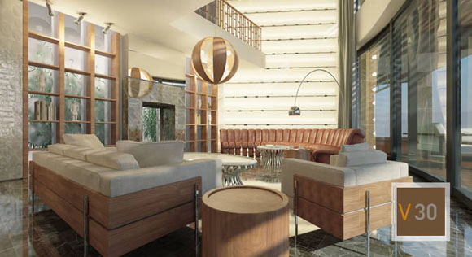
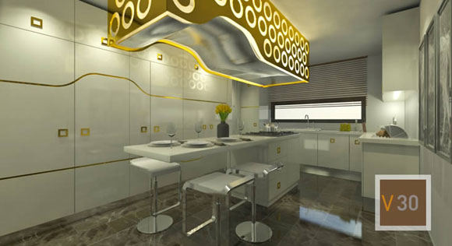
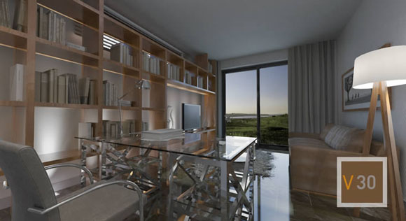

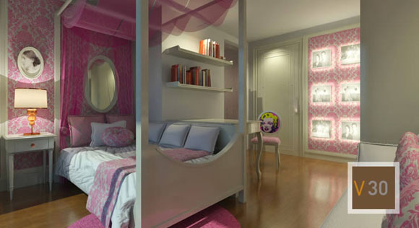
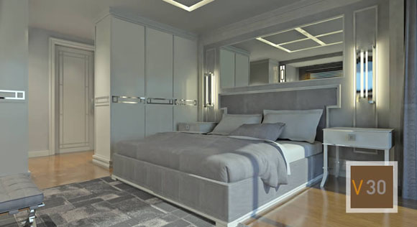
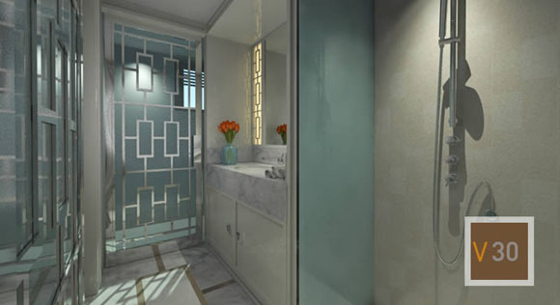






Slide 32

In addition, we will create comfortable, safe environment, relaxing and exiciting zone.
To build: -Club house
-School
-Kindergarten
-Hospital

Slide 33


Club house
Area of 10,000 square meters within the borders of tennis, basketball court, indoor and outdoor pools, restaurant, fitness center and a member of the social facilities will be available only from the outside, not VIP ECO residents. Input from outside the facility planned in consideration of the social order to survive.
3000 square-foot children's park, recreation area, ornamental pools, and plants. There is also a pond in the middle of VIP ECO . Social facility has a separate administration building VIP ECO .

Slide 34
PREVIOS BUDGET FOR BENEFIT, INVESTMENT AND CONSTRUCTION OF TOWN HOUSE
Number of total house | 130
Float date | In 2012 year 20 house In 2013 year 50 house In 2014 year 60 house
Total construction square of project | 200000m2
Starting investment | 15 000 000 $
Total investment | 117 500 000 $
Cost of substructure and per household | 750 000 $
Total sales house | 130
Selling cost of per house | 2 000 000 $
Total selling cost of project | 26 000 000 $
Project total cost | 117 500 000 $
Total benefit of project | 142 500 000 $
Project benefit percent | 54.8%
Project implementing period | 4 years

Slide 35
CASH FLOW STATEMENT
(2012-2014)
 |  | Beginning | Overview | Overview | Total
 |  | 2012 | 2013 | 2014
INFLOWS FROM OPERATING ACTIVITIES | Үйл ажиллагаанаас орсон бэлэн мөнгө
Cash Sales | Борлуулалтын орлого | 40,000,000 | 100,000,000 | 120,000,000 | 260,000,000
Collection of Accounts Receivable | Үйл ажиллагааны орлого |  |  |  | 0
Other Sources of Income |  |  |  |  | 0
Other Sources of Income |  |  |  |  | 0
Total Cash Collected | Нийт орсон бэлэн мөнгө | 40,000,000 | 100,000,000 | 120,000,000 | 260,000,000

Slide 36
OUTFLOWS FROM OPERATING ACTIVITIES | Үйл ажиллагаанд зарцуулсан бэлэн мөнгө | 2012 | 2013 | 2014 | TOTAL
Purchases of Raw Materials with VAT charged | Барилгад зарцуулах зардал | 15,000,000 | 37,500,000 | 45,000,000 | 97,500,000
Officer's Payroll (including Social Security, Gross) | Дэд бүтцэд зарцуулах зардал |  |  |  | 0
Transportation | Ерөнхий удирдлагын цалин | 120,000 | 120,000 | 120,000 | 360,000
Utilities (Energy, Gas, Water) | Ашиглалтын зардал (эрчим хүч, хий, ус) | 5,000 | 8,000 | 8,000 | 21,000
Advertising & Marketing Expense | Түрээс |  |  |  | 0
Owners Salary, without Social Security | Холбооны зардал | 5,000 | 8,000 | 8,000 | 21,000
Rent | Маркетингийн зардал | 200,000 | 340,000 | 150,000 | 690,000
Spare parts, fuel | Сэлбэг, шатахуун зардал | 20,000 | 30,000 | 30,000 | 80,000
Income Taxes | Орлогын татвар | 8,615,250 | 21,685,650 | 26127150 | 56,428,050
Other taxes or Fees /VAT/ | Бусад татвар, төлбөр /НӨАТ/ |  |  |  | 0
Payment of Accounts Payable | Бичиг хэрэг | 10,000 | 10,000 | 10,000 | 30,000
Other | Бусад | 10,000 | 10,000 | 10,000 | 30,000
Total Operating Outflows | Үйл ажиллагаанд зарцуулсан нийт бэлэн мөнгө | 23,985,250 | 59,711,650 | 71,463,150 | 155,160,050
CASH FLOW FROM OPERATIONS | ҮЙЛ АЖИЛЛАГААНЫ БЭЛЭН МӨНГӨНИЙ УРСГАЛ | 16,014,750 | 40,288,350 | 48,536,850 | 104,839,950

Slide 37
INFLOWS AND OUTFLOWS FROM INVESTING ACTIVITIES | ХӨРӨНГӨ ОРУУЛАЛТААС ОРСОН, ГАРСАН БЭЛЭН МӨНГӨ | 2012 | 2013 | 2014 | TOTAL
Cash Injections from Owners (Investment) (+) | Эзний оруулсан бэлэн мөнгө (хөрөнгө оруулалт) (+) | 15,000,000 |  |  | 15,000,000
Sales of Assets (+) | Худалдсан хөрөнгө (+) | 0 |  | 0 | 0
Purchase of Fixed Assets or other investment (-) | Худалдаж авсан үндсэн хөрөнгө ба бусад хөрөнгө оруулалт | 0 |  |  | 0
Total Investment Inflows and Outflows | Нийт хөрөнгө оруулалтаар орсон, гарсан б/мөнгө | 15,000,000 | 0 | 0 | 15,000,000
CASH FLOW BEFORE FINANCING | САНХҮҮЖИЛТИЙН ӨМНӨХ БЭЛЭН МӨНГӨНИЙ УРСГАЛ | 15,000,000 | 0 | 0 | 15,000,000

Slide 38
INFLOWS AND OUTFLOWS FROM FINANCING ACTIVITIES | САНХҮҮЖИЛТИЙН ҮЙЛ АЖИЛЛАГААНААС ОРСОН, ГАРСАН БЭЛЭН МӨНГӨ | 2012 | 2013 | 201 4 | TOTAL
Bank Loan (+) | банкны зээл (+) |  |  |  | 0
Other Bank Loans (+) | Бусад зээл (+) |  |  |  | 0
Interest Payments (-) | банкны зээлийн хүүгийн төлбөр (-) |  |  |  | 0
Other Loan Repayments (-) | Бусад зээлийн төлбөр (-) |  |  |  | 0
Other Loan Interest Payments (-) | Бусад зээлийн хүүгийн төлбөр (-) |  |  |  | 0
Other inflows or outflows (+) (-) | Бусад орсон, гарсан бэлэн мөнгө |  |  |  | 0
Total Financing Inflows and Outflows | Нийт санхүүжилтээр орсон, гарсан бэлэн мөнгө | 0 | 0 | 0 | 0
NET CASH FLOW | ЦЭВЭР БЭЛЭН МӨНГӨНИЙ УРСГАЛ | 31,014,750 | 40,288,350 | 48,536,850 | 104,839,950
BEGINNING CASH BALANCE | БЭЛЭН МӨНГӨНИЙ ЭХНИЙ ҮЛДЭГДЭЛ |  | 31,014,750 | 71,303,100
ENDING CASH FLOW | БЭЛЭН МӨНГӨНИЙ ЭЦСИЙН ҮЛДЭГДЭЛ | 31,014,750 | 71,303,100 | 119,839,950

Slide 39
Pretax & preinterest financial income | Хүү ба татварын өмнөх ашиг | 2012 | 2013 | 2014 | TOTAL
 |  | 24,615,000.0 | 61,959,000.0 | 74,649,000.0
Bank Loan interest payment | Банкны зээлийн хүүгийн төлбөр
Other Bank Loans interest payment | Бусад банкны зээлийн хүүгийн төлбөр
Pretax financial income | Татварын өмнөх ашиг | 24,615,000.0 | 61,959,000.0 | 74,649,000.0
Income taxes | Орлогын татвар | 8,615,250.0 | 21,685,650.0 | 26,127,150.0
NET INCOME | ЦЭВЭР АШИГ | 15,999,750.0 | 40,273,350.0 | 48,521,850.0 | 104,794,950.0

Slide 40
INCOME STATEMENT
 |  | Projected Төсөөлөл | Projected Төсөөлөл | Projected Төсөөлөл
 |  | 2012.5-2012.12 | 2013.1-2013.12 | 2014.1-2014.12
Sales revenue | Борлуулалтын орлого | 40,000,000.0 | 100,000,000.0 | 120,000,000.0
Total Sales revenue | Нийт борлуулалт | 40,000,000.0 | 100,000,000.0 | 120,000,000.0
Cost of sales | Борлуулсан барааны өртөг
Cost of sales | Борлуулсан (1) барааны өртөг | 15,000,000 | 37,500,000 | 45,000,000
Cost of sales | Борлуулсан барааны нийт өртөг | 15,000,000 | 37,500,000 | 45,000,000
Total profit | Нийт ашиг | 25,000,000 | 62,500,000 | 75,000,000

Slide 41
OPERATION COST
Management salary,social insurance | Ерөнхий удирдлагын цалин, НДШ | 120,000.0 | 120,000.0 | 120,000.0
Transportation | Тээвэр
Utilities (Energy, Gas, Water) | Ашиглалтын зардал (Эрчим хүч, хий, ус) | 5,000.0 | 8,000.0 | 8,000.0
Rent | Түрээс
Communication cost | Холбооны зардал | 5,000.0 | 8,000.0 | 8,000.0
Advertising & Marketing Expense | Маркетингийн зардал | 200,000.0 | 340,000.0 | 150,000.0
Spare parts, fuel | Сэлбэг, шатахууны зардал | 20,000.0 | 30,000.0 | 30,000.0
Other tax , fee | Бусад татвар буюу хураамж
Deprecation expense | Элэгдэл | 15,000.0 | 15,000.0 | 15,000.0
Other | Бусад | 20,000.0 | 20,000.0 | 20,000.0
Total opertaion cost | Нийт үйл ажиллагааны зардал | 385,000.0 | 541,000.0 | 351,000.0

Slide 42
Pretax & preinterest financial income | Хүү ба татварын өмнөх ашиг | 2012 | 2013 | 2014 | TOTAL
 |  | 24,615,000.0 | 61,959,000.0 | 74,649,000.0
Bank Loan interest payment | банкны зээлийн хүүгийн төлбөр
Other Bank Loans interest payment | Бусад банкны зээлийн хүүгийн төлбөр
Pretax financial income | Татварын өмнөх ашиг | 24,615,000.0 | 61,959,000.0 | 74,649,000.0
Income taxes | Орлогын татвар | 8,615,250.0 | 21,685,650.0 | 26,127,150.0
NET INCOME | ЦЭВЭР АШИГ | 15,999,750.0 | 40,273,350.0 | 48,521,850.0 | 104,794,950.0

Slide 43
THANK YOU FOR YOUR ATTENTION

